Slide 1
JAC444 - Lecture 3
Object-Oriented Concepts
Segment 1 - Object Class
Updated By: Mahboob Ali

Slide 2
Objectives
Upon completion of this lecture, you should be able to:
Explore the Object Class
Apply Inheritance Concept in Java
Utilize Polymorphism Concept in Java
Experiment with Namespace in Java - Package

Slide 3
Object Class
In this segment you will be learning about:
java.lang.Object Class
Methods of the Object Class
Develop Classes using Object Class
Construct a Pattern for Designing Classes in Java

Slide 4
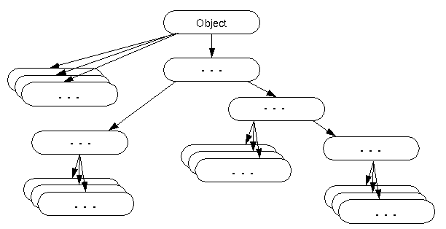
Object Class
The class Object is the root of the Java class hierarchy,
in other words, Object class is the parent class of all the classes in java.

Slide 5
It is defined in the package java.lang
If no inheritance is specified when a class is defined, the superclass of the class is Object.
One MUST understand all methods defined in the Object class, since every class developed in Java inherits all its methods.

Slide 6
Methods in Object Class
There are 11 methods in Object class.
Object boolean void Class<?> int
void void String void void void
clone() equals(Object obj) finalize() getClass() hashCode() notify() notifyAll() toString()
wait()
wait(long timeout)
wait(long timeout, int nanos)

Slide 7
toString() Method
The toString() method does not take any parameters and returns a string representation of the object.
The string must contain the state (field values) of the object.
Every class that you develop must override this method

Slide 8
What will be the output?
class Student{
int rollno;
String name;
String city;
Student(int rollno, String name, String city){
this.rollno=rollno;
this.name=name;
this.city=city;
}
public static void main(String args[]){
Student s1=new Student(101,“Sam",“Toronto");
Student s2=new Student(102,“Jack",“Markham");
System.out.println(s1);//compiler writes here s1.toString()
System.out.println(s2);//compiler writes here s2.toString()
}
}
How can we fix the Problem?
public String toString(){//overriding the toString() method
return rollno+" "+name+" "+city;
}
Output:Student@1fee6fc
Student@1eed786

Slide 9
equals(Object obj) Method
The equals method takes an object of type Object as param and returns a boolean value.
The default implementation of the equals method in the Object class is as follows:
public boolean equals(Object obj) {
return (this == obj);
}
The method compares the current object with the object given as param
It is generally necessary to override the hashCode method whenever equals method is overridden

Slide 10
hashCode() Method
The hashCode method does not take any param and returns a integer value as hash code value.
(a hash code value is a 32-bit signed integer which represents the data stored in the object - see implementation example in the sample provided)
int hashCode()
If two objects are equal according to the equals(Object) method, then calling the hashCode() method on each of the two objects must produce the same integer result.

Slide 11
Class<?> getClass()
The getClass() method does not take any param and returns the runtime class of this Object
public final Class<?> getClass()
Example of using getClass() method
byte[] bytes = new byte[10]; Class c = bytes.getClass(); String className = c.getName();
Instances of the class Class represent classes and interfaces in a running Java application

Slide 12
wait() and notify() Methods
The methods wait() and all its overloaded methods with
notify() and notifyAll() are used in multithreading
More about them in the lecture about Thread in Java
Since these methods are inherited in all classes any object could invoke them

Slide 13
Question
Read the following class:
public class Question {
public static void main(String[] args) { Question obj = new Question(); String s = obj.toString(); System.out.println(s);
}
}
Can we invoke method toString on an object of type Question ? YES. Since Question class inherits from Object class all its methods. What is it printed?
The string returned from the invocation of toString method in the Object class:
Question@3cd1a2f1 (name of the class @ hashcode of the obj)

